Slide 1

Pac-Man API Design
Team: Chaos
Team Lead: Yuyu Qian
Tech Lead: Renhao Lei
Doc Lead: Jian Chen
Developer: Yudai Chen
Yang Lyu
Xuejuan Yang
https://pacman-team-chaos.herokuapp.com/
Notes:
Hello everyone, we are team Chaos. Today’s presentation we will introduce you guys about our Pacman Game API design. I am the Team Lead Yuyu. This is our Tech Lead Renhao, Doc Lead Jian, and Developers Yang, Yudai, Xuejuan

Slide 2
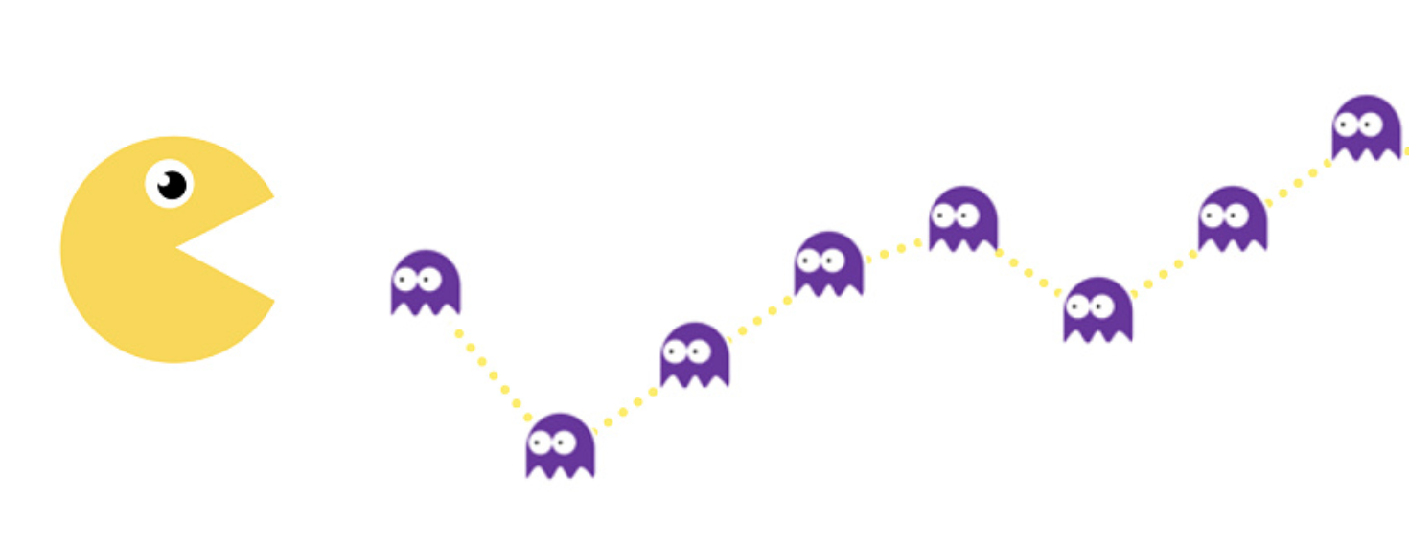
Introduction
Pacman is a great game.
We want to reproduce the great.
https://pacman-team-chaos.herokuapp.com/
Notes:
Pacman used to be one of the most popular games in the world, we are trying to reproduce it.

Slide 3

Introduction
Modeling
Entity States
Personalities and Strategy
Frontend Drawing
Conclusion and Demo
https://pacman-team-chaos.herokuapp.com/
Notes:
Our presentation contains five parts.
Modeling is about How do we model the objects.
Entity States is about How do we control the game process.
Personalities and Strategy is about How do we give the ghosts different behaviors.
Frontend Drawing is about How do we draw the game.
Conclusion and Demo: How is our game now.

Slide 4
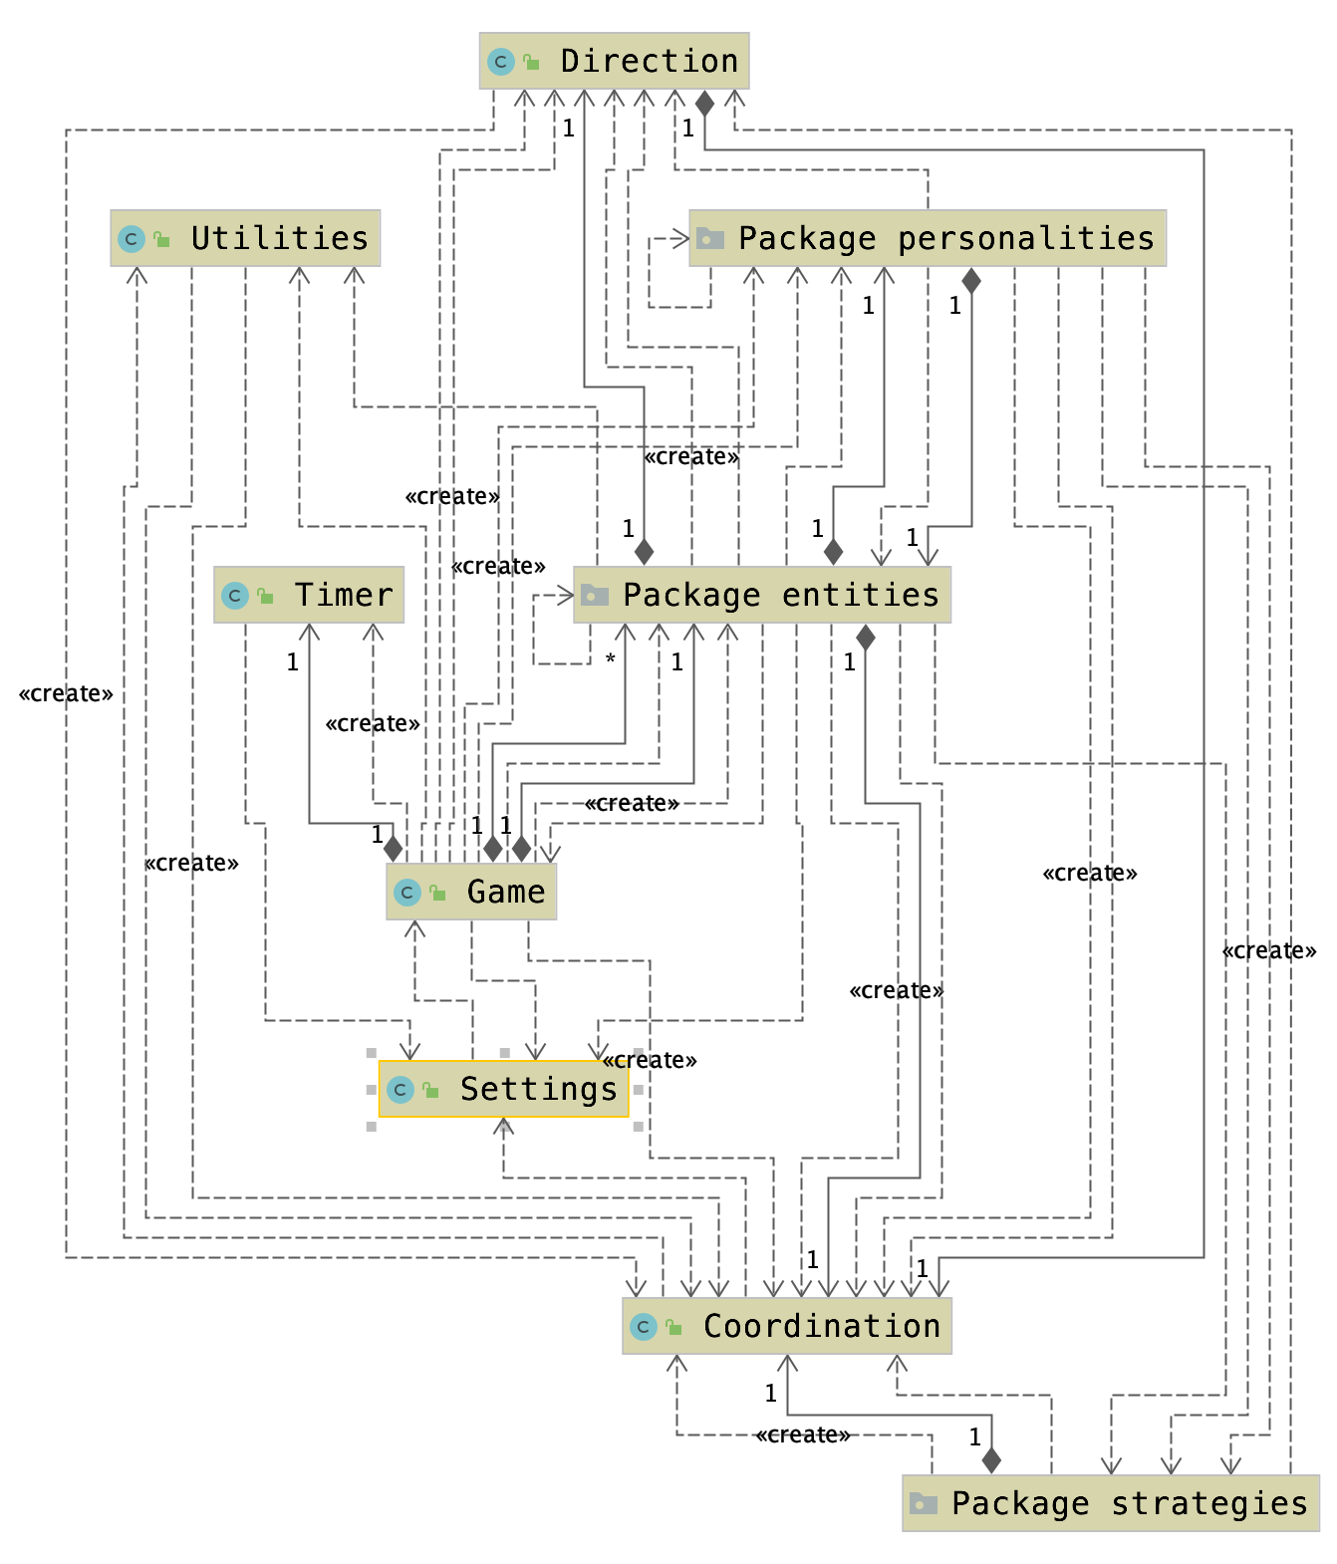
Introduction
https://pacman-team-chaos.herokuapp.com/
Notes:
The UML diagram shows our project’s structure containing the interfaces and classes we use. Now let my teammate Yang talked about our entity model.

Slide 5
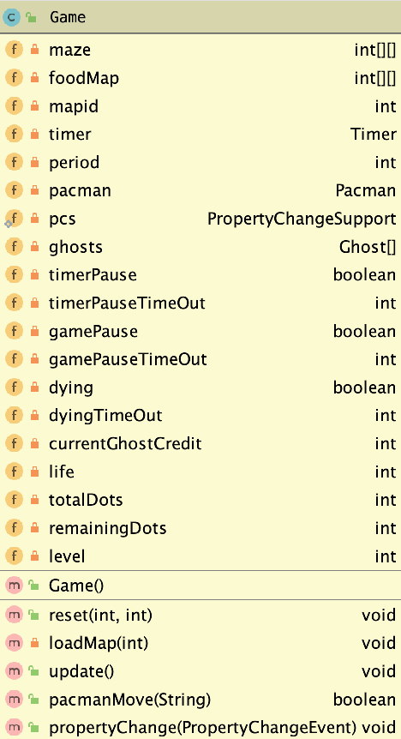


Game
https://pacman-team-chaos.herokuapp.com/
Notes:
Well, At first, when user open the game, the game will initialize all elements like maze, pacman and ghost. So we create a class “game” and use some fields to load the elements.
The game class is like a dispatch adapter to communicate with the model and view.

Slide 6
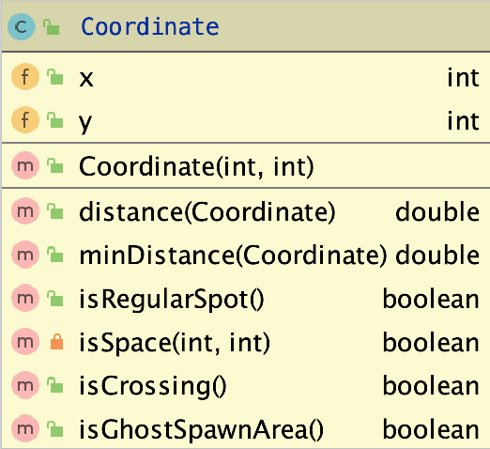
Coordinate
Represent the 2-dimension coordinate
A pair of int
Logical or physical
https://pacman-team-chaos.herokuapp.com/
Notes:
Besides, every object has coordinate. So we create a coordinate class to represent logical coordinate or physical coordinate of the objects.
We use logical coordinate to get map elements, because the map is store with the logical address in a 2-dimensional array. Just like this

Slide 7
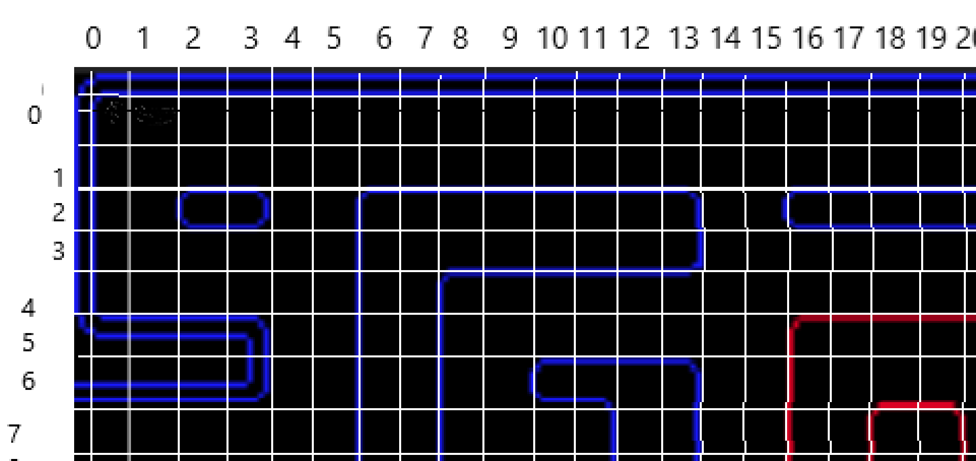
1 x 1 grid contains 20 x 20 pixels on canvas
logical coordinate (2, 2) will be mapped to physical coordinate(50, 50)
This is how we store the maze in a 2D array.
https://pacman-team-chaos.herokuapp.com/
Notes:
Also because one unit cell may contain many pixels, when we draw objects on canvas, we should use their physical coordinate.

Slide 8
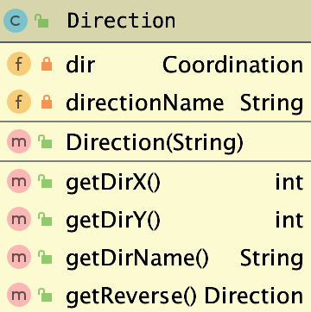





Direction
https://pacman-team-chaos.herokuapp.com/
Notes:
The “Direction” class is used to represent the current direction of the moving object ghosts and pacman.

Slide 9
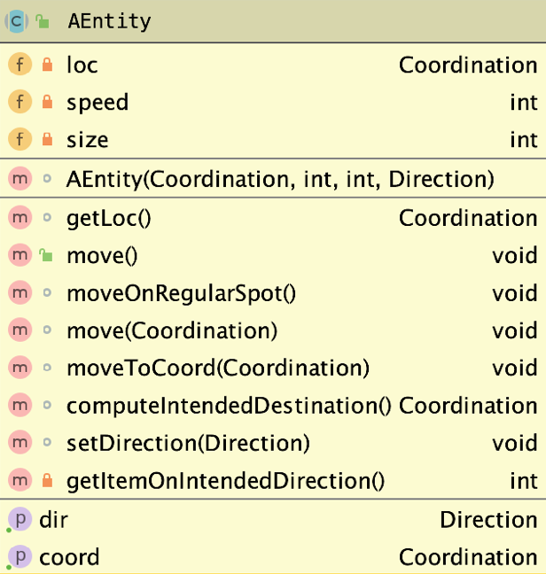
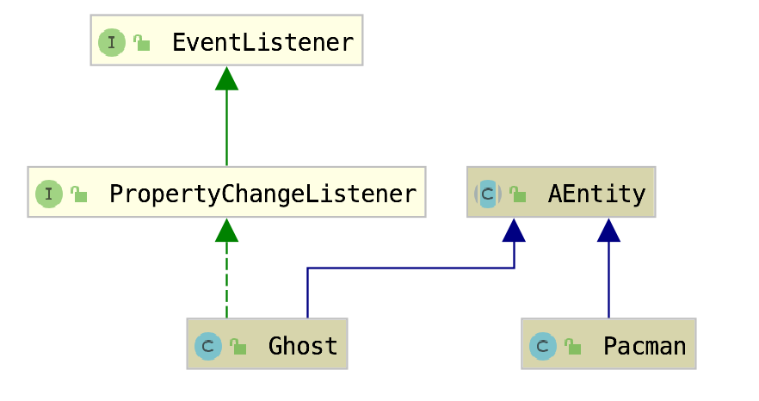
AEntity
https://pacman-team-chaos.herokuapp.com/
Notes:
Since the ghost and pacman have some common features and behaviors, we create an abstract class AEntity to be extended by concrete classes Pacman and Ghost

Slide 10
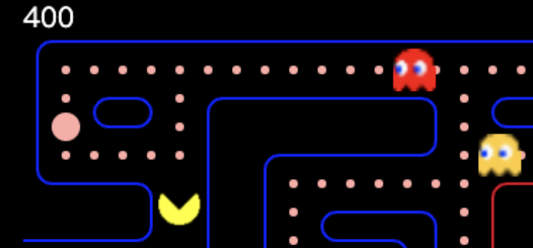
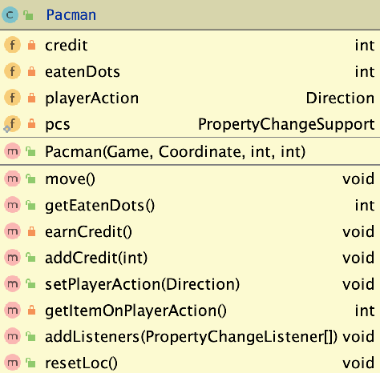
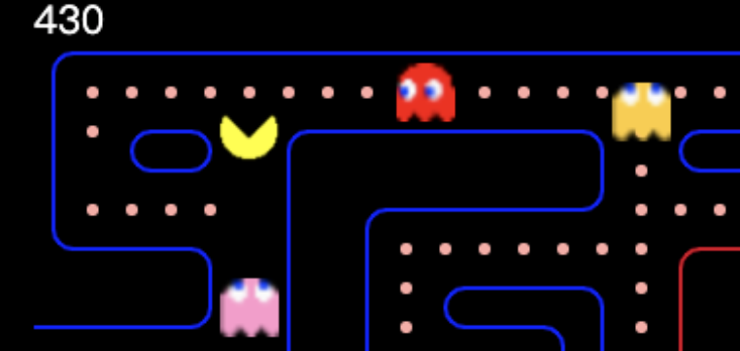
Pac-Man
https://pacman-team-chaos.herokuapp.com/
Notes:
For a pacman, to accumulate the credits it gets, we have field credit.
To control the pacman, we have the field playerAction to store the direction that input through keyboard.

Slide 11
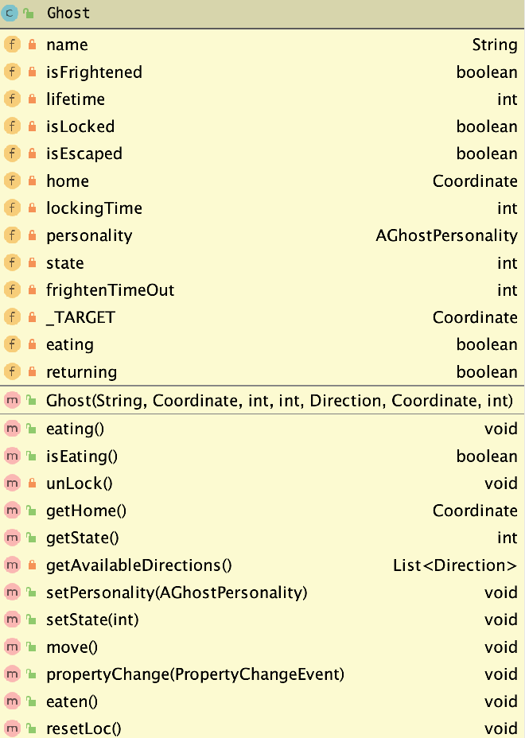








Ghost
CHASE
SCATTER
EATEN
FRIGHTENED
https://pacman-team-chaos.herokuapp.com/
Notes:
For ghosts, the field personality can determine their moving direction in certain state.
The field state is used to represents different behaviors under certain game period or event.
In the next section, my teammate is gonna talk about the field state in detail.

Slide 12
Ghosts’ state
Every ghost has its own
state:
Ready
Scatter
Chase
Frighten
Eaten
Changed by two subjects:
Timer
Event
https://pacman-team-chaos.herokuapp.com/
Notes:
We use ghosts’ state to control the game process.Ghost states can be changed by two subjects: timer and event.

Slide 13
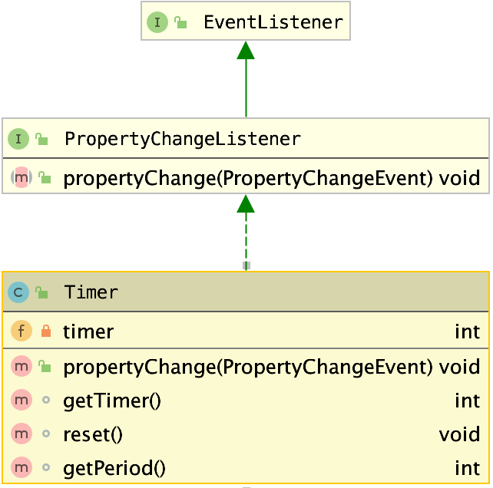

Ghosts’ state
Timer
Timer increments by one at every update
Timer determines the game period and ghosts’ state
Timer gets reset when the game level changes or Pacman dies
https://pacman-team-chaos.herokuapp.com/
Notes:
We use timer as a reference to change ghosts’ states.

Slide 14
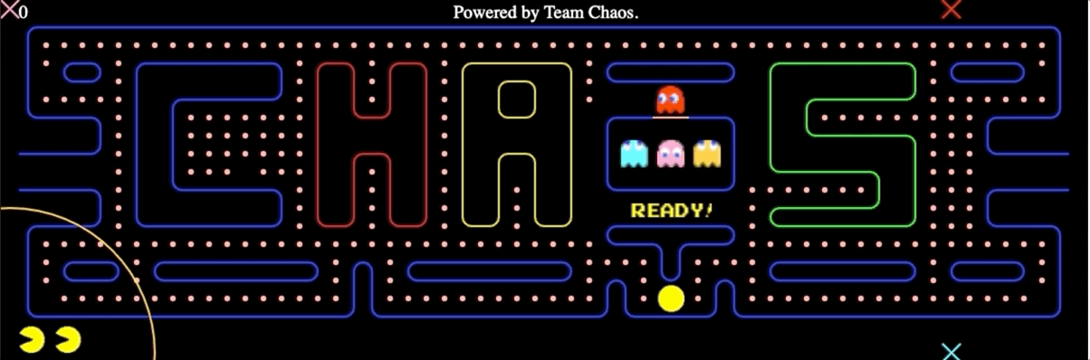

Ghosts’ state
States changed by Timer:
Ready
https://pacman-team-chaos.herokuapp.com/
Notes:
As I mentioned before, Timer is referenced to set the ghosts’ state in the update method.
Pacman and ghosts are in Ready state at the beginning of the game and cannot move in this state.

Slide 15
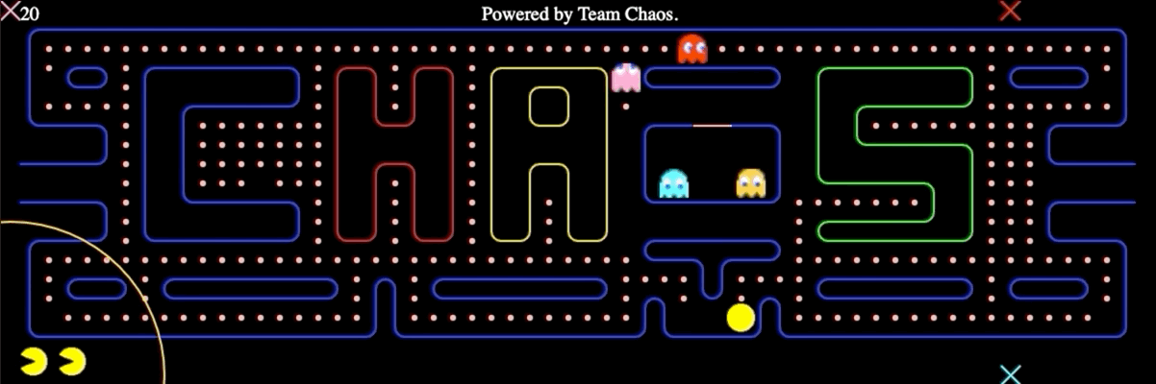
Ghosts’ state
States changed by Timer:
Scatter
https://pacman-team-chaos.herokuapp.com/
Notes:
Ghosts will stop chasing for a few seconds and head for their corresponding home corners when they have scatter state.

Slide 16
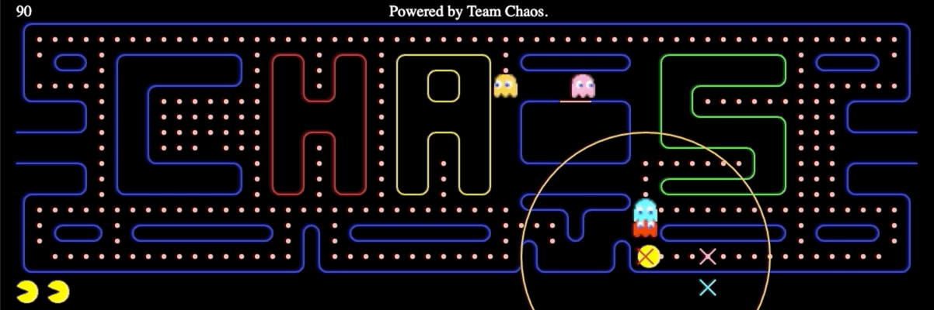
Ghosts’ state
States changed by Timer:
Chase
https://pacman-team-chaos.herokuapp.com/
Notes:
Four ghost will target at different positions depending on their personalities when they have chase state.

Slide 17
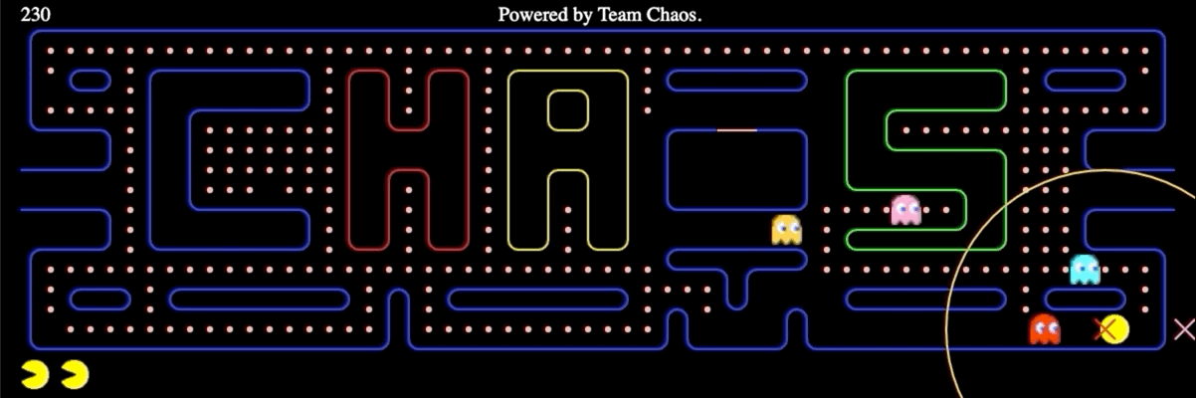
Ghosts’ state
States changed by Event:
Frighten
https://pacman-team-chaos.herokuapp.com/
Notes:
EarnCredit method will fire an event to set the frighten state when Pacman eats one of the energizers, then ghosts will turn around and choose directions randomly.

Slide 18
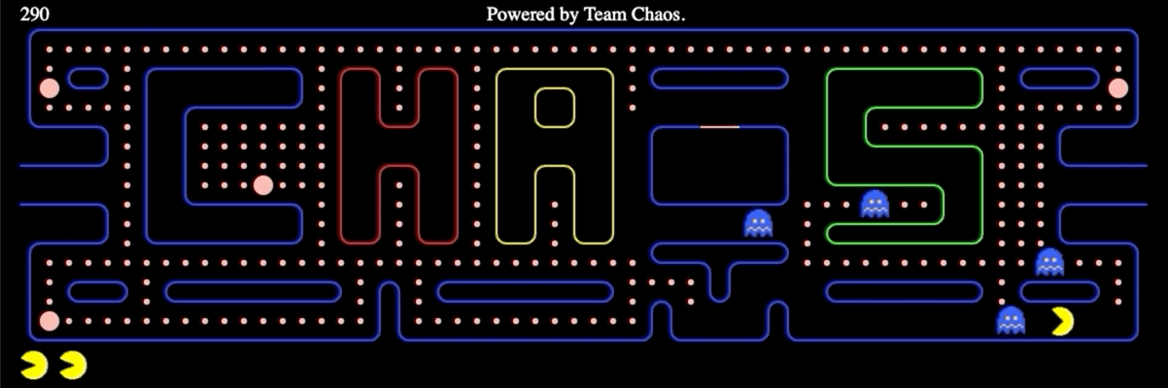
Ghosts’ state
States changed by Event:
Eaten
https://pacman-team-chaos.herokuapp.com/
Notes:
Update method will fire an event to set eaten state when Pacman eats one of the ghosts. The eaten ghost will turn into eyes and go back to ghosts’ home.
Now we have talked about how do we control the game process. How do we determine the ghost behaviors in each game period? My teammate Yudai will discuss this part.
6 29

Slide 19
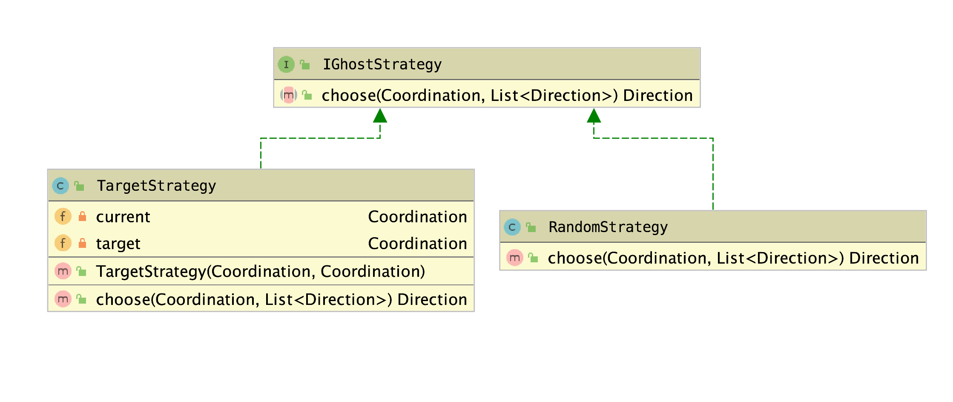
Strategy
https://pacman-team-chaos.herokuapp.com/
Notes:
As my partner has mentioned, when each ghost’s state switches, the move pattern of it will also switch. Each ghost should make a decision when it comes to a crossing. So we implement an interface providing choose() method to select an available direction. Generally, there are two kinds of strategies, the random strategy and the target strategy. The former will choose a direction randomly, while the later always chooses a direction which will make the ghost approach a specific target. (GIf: ghost in the cross)

Slide 20
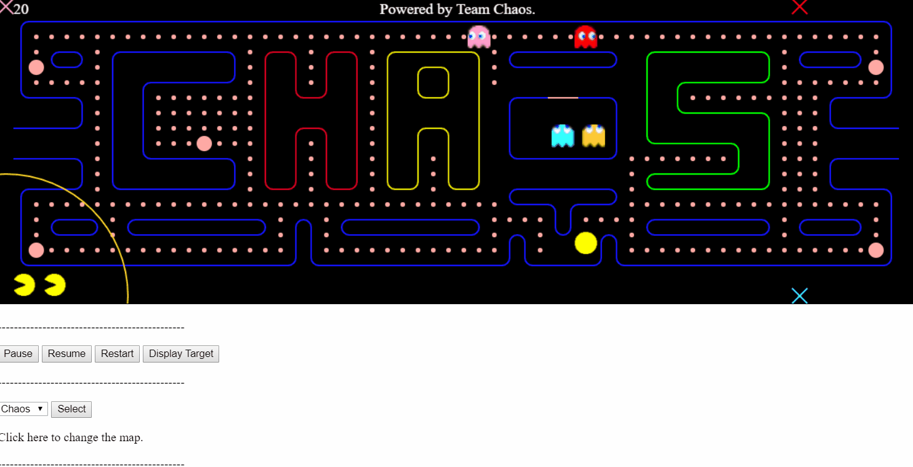
Strategy
https://pacman-team-chaos.herokuapp.com/
Notes:
In the demo, you can see there are X marks of different colors. Each represents the target of the ghost of corresponding color. When the ghost enters a different state, the location of the target will change. Besides, ghosts with different personalities will have different targets. I’ll show you how we achieve this feature.

Slide 21
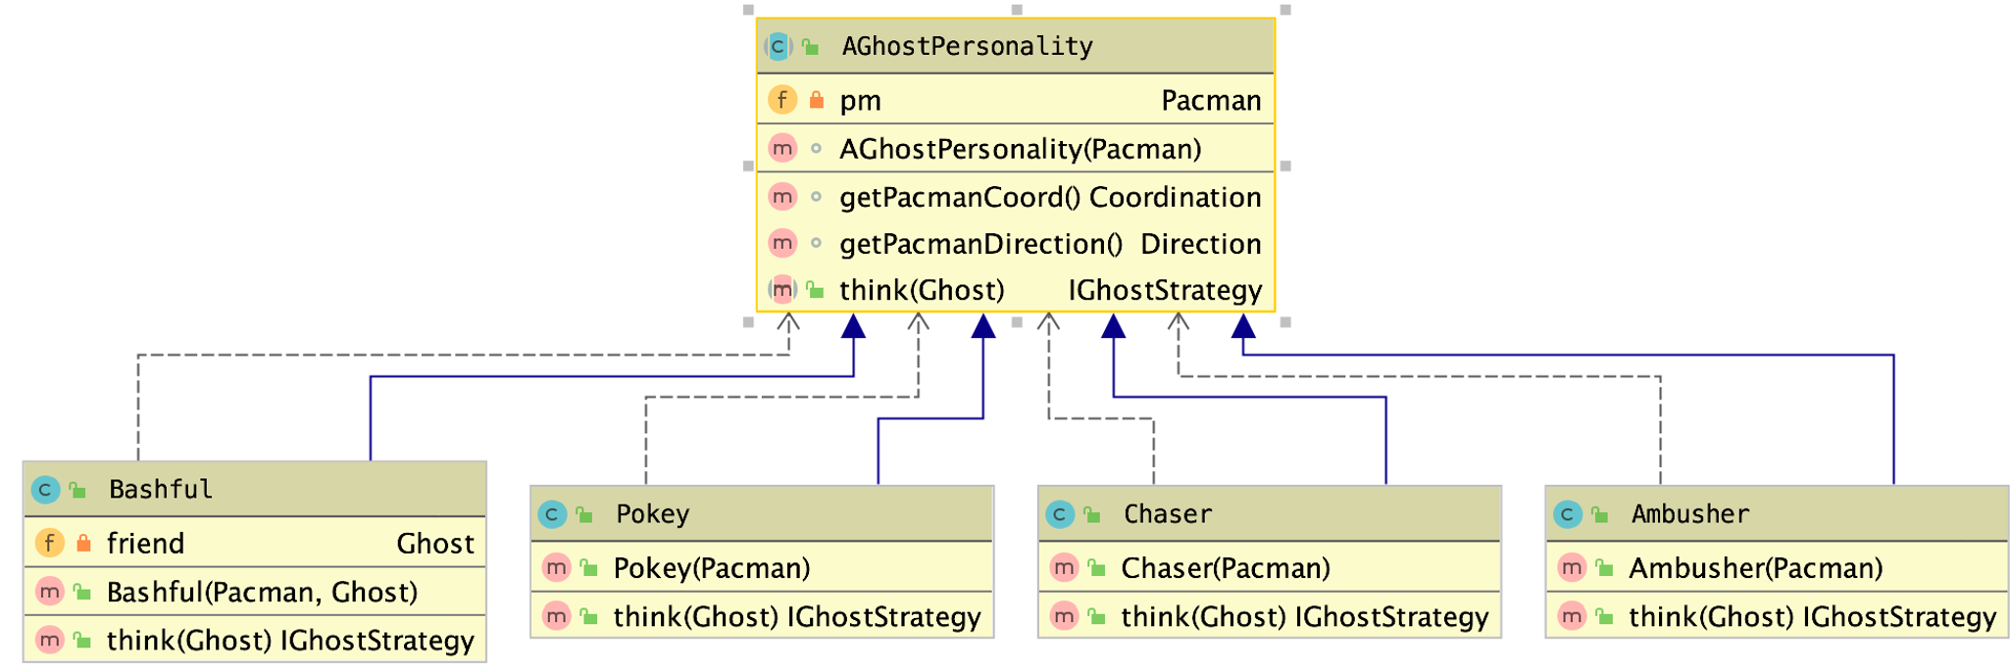
Personality
https://pacman-team-chaos.herokuapp.com/
Notes:
As you can see, we implement an abstract class AGhostPersonality, which represents the character of a ghost. When the ghost enters a crossing, the think method is called and it returns a strategy which determines the next move. Next, we are going to demonstrate how do we draw the game in the front end.
*** Ambusher: The host's target tile in Chase mode is determined by looking at Pac-Man's current position and orientation, and selecting the location four tiles straight ahead of Pac-Man.
*** Bashful: To locate the target in Chase period, we first start by selecting the position two tiles in front of Pac-Man in his current direction of travel. From there, imagine drawing a vector from a ghost friend's position to this tile, and then doubling the length of the vector. The tile that this new, extended vector ends on will be the host's actual target.
*** Chaser: Using Pac-Man's current tile as his target. *** Pokey: If he is farther than eight tiles away, his targeting is the Pac-Man's current tile. However, as soon as his distance to Pac-Man becomes less than eight tiles, the host's target is set to its home.

Slide 22
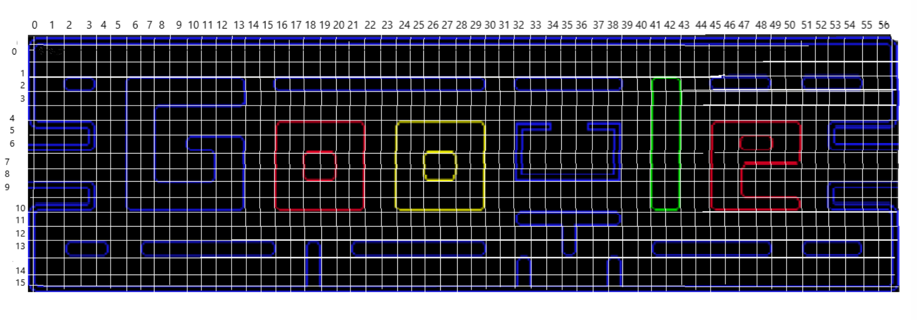
Map Design
https://pacman-team-chaos.herokuapp.com/
Notes:
This is the layout of the pac-man world. Each grid in the layout is mapped as an element in a matrix. We use two matrixes to construct the map

Slide 23
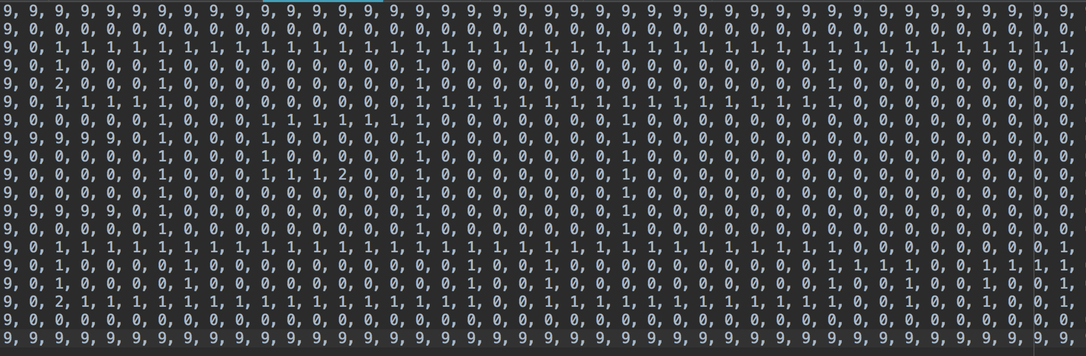

Map Design
1 -> dot
2 -> energizer
3 -> fruit
https://pacman-team-chaos.herokuapp.com/
Notes:
This is the food txt file. Different digits represent different bonus.

Slide 24
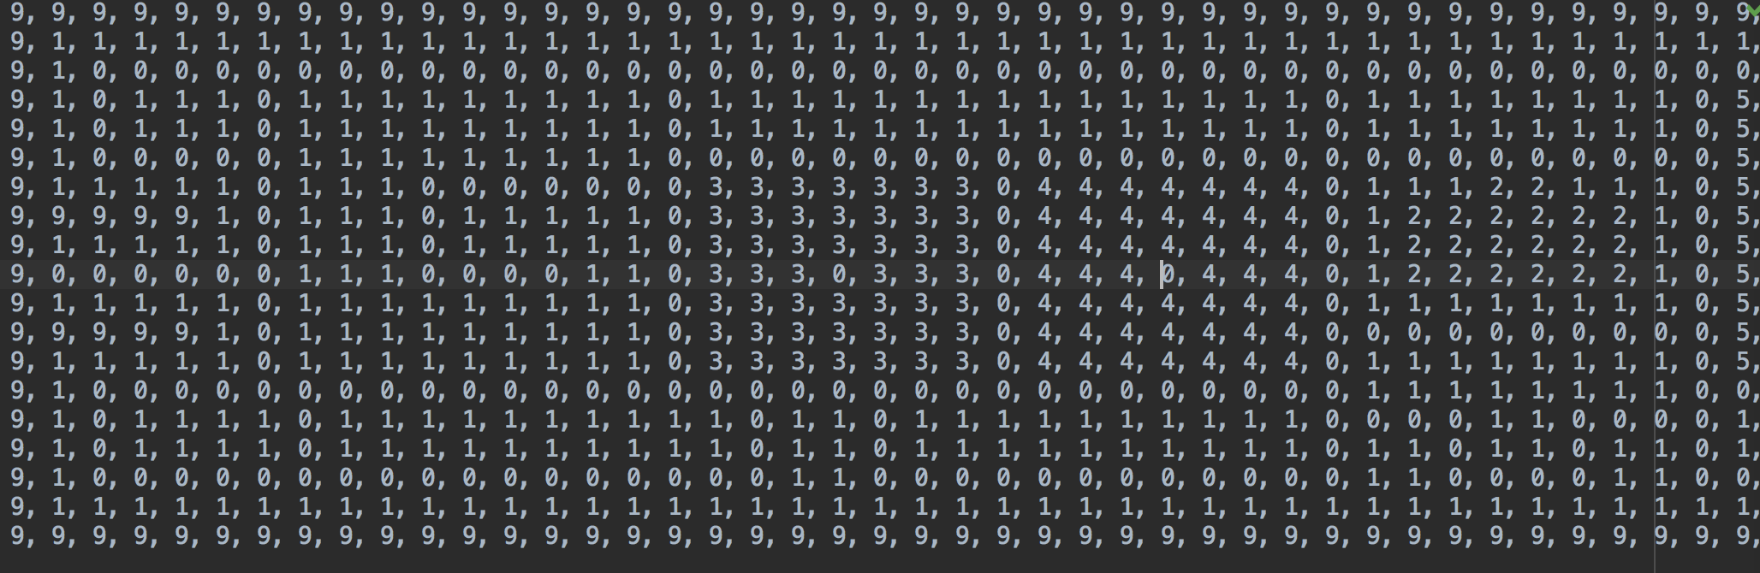

Map Design
9 -> edge
0 -> space
1,3,4 -> walls
https://pacman-team-chaos.herokuapp.com/
Notes:
This is the maze txt file. Different numbers represent different objects.
In the Game class, it has two matrix fields. When program loads, it will read those files.

Slide 25


MVC
https://pacman-team-chaos.herokuapp.com/
Notes:
The view will send a GET request to update the world, and the controller will send back the Game() object encoded by GSON.
When the game is loaded, the frontend will detect keystroke and send POST request to the controller. The controller will then tell Game object to take the corresponding action of the Pac-Man.
The frontend will dynamically draw the map with updated entities based on the data returned from the controller.

Slide 26

Conclusion
Extensibility
Change maps by replacing map txt files
Change food by replacing food map files
Add Pac-Man by calling its constructor
Add ghosts by calling their constructors
Creativity
Players can choose maps
https://pacman-team-chaos.herokuapp.com/
Notes:
So in conclusion, our pacman game has great extensibility since we could update maps and food information by replacing the text files, and could add more pac-men and ghosts by calling their constructors.
We are also creative enough to modify the game a little, for example, players can choose different maps.

Slide 27
Demo
Now: our demo.
https://pacman-team-chaos.herokuapp.com/
Notes:
The game starts. ghosts are in the scatter state.
()
Right now is the chase state.
()
Now frightened state
()
Eaten state now.
()
We can also change the map of the game.
(keep playing if necessary)

Slide 28


Questions?
https://pacman-team-chaos.herokuapp.com/

Slide 29

Thank you!
https://pacman-team-chaos.herokuapp.com/

